Slide 1

Filter press
Presentation

Slide 2
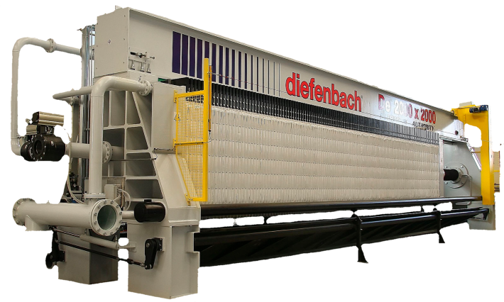
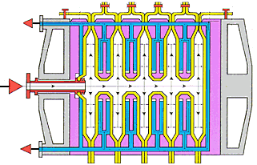

What is a filter press
Fixed head drive side
The filter press consists of two fixed heads (feeding side and drive side), an overhead beam or two side beams and a moving head containing a pack of vertical rectangular/squared plates;
Each filter plate is dressed with a filter cloth on both sides and, once pressed together, they form a series of chambers whose number depends on the plate number;
The fixed head feeding side serves as a fixed end to which the feed and filtrate pipes are connected. The moving head moves along the beam and presses the plates together during the filtration cycle by a hydraulic or mechanical mechanism. The plates have a feed port and 2-4 filtrate ports running along the entire length of the filter press, so that all the chambers of the plate pack are connected together.
Fixed head feeding side
Plates
Moving head
Feeding port (slurry)
Filtering port
Filter cloths

Slide 3

Fields of application

Slide 4

Resources involved
Diefenbach
Sizing and characterization of the filter press
Technical department
R&D
Pilot filter
Commercial department
4°
Commercial proposal
1°
3°
Technical proposal
2°

Slide 5
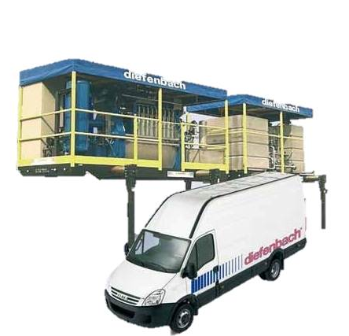
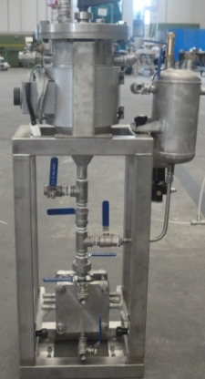
Resources involved
Process Department
R&D
Pilot filter
  Filter characterization and sizing
  Study of the filtration process adapted to the customer's needs
  Filtration tests on the customer's sludge using pilot filters
  Identification of the best filtration system

Slide 6
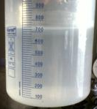
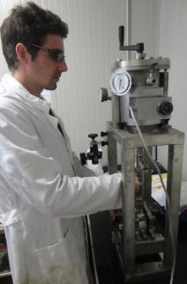
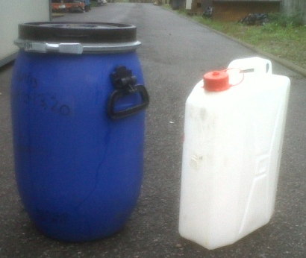
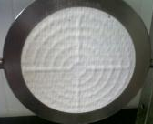
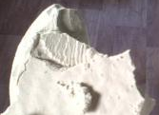
Resources involved
R&D – Pilot filter
Filtrate
Sludge samples
Test with pilot filter
Cake /
Residual solid

Slide 7
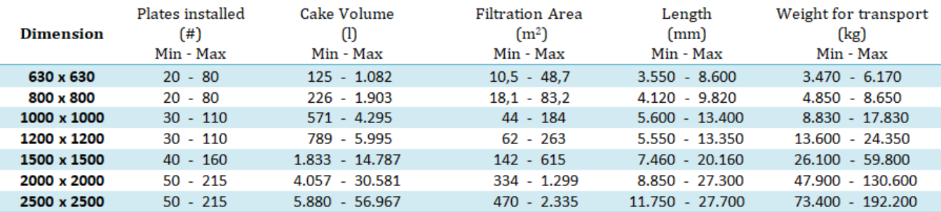
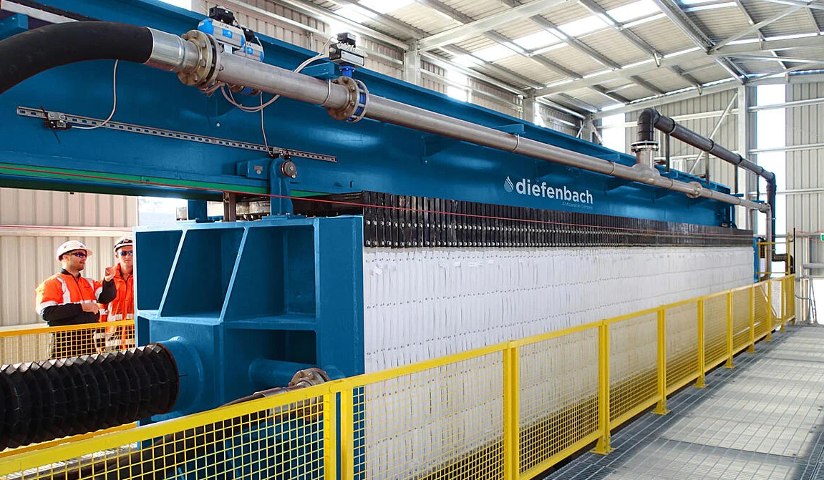
Portfolio
Overhead beam model(DE)
Type: High beam (DE)
Plate transport: One by one
Cloths change: Without removing the plates
Maintenance: Simple

Slide 8
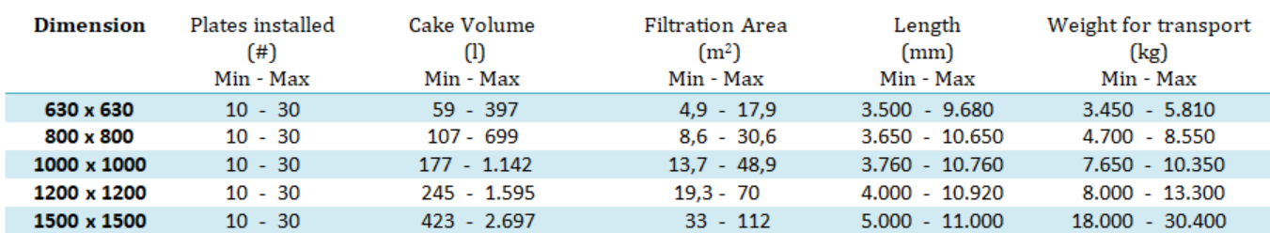
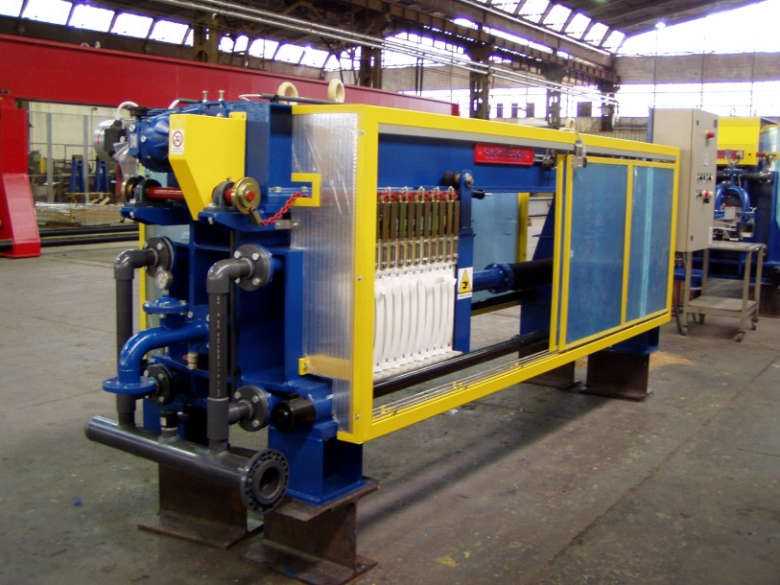
Portfolio
Overhead beam model(DE IST)
Type: High beam (DE)
Plate transport: Simultaneous (IST)
Cloths change: Without removing the plates
Maintenance: Simple

Slide 9
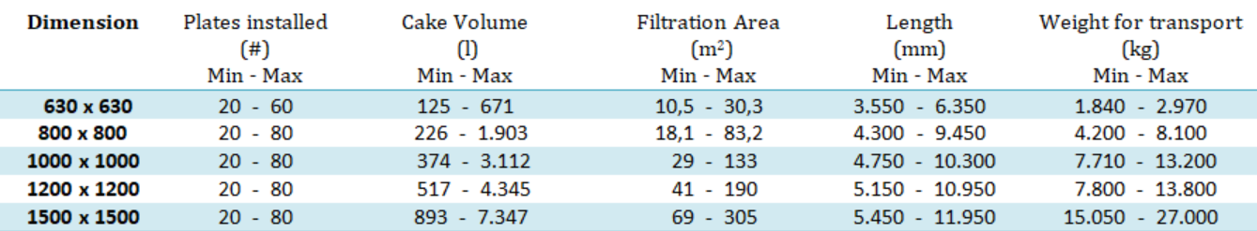
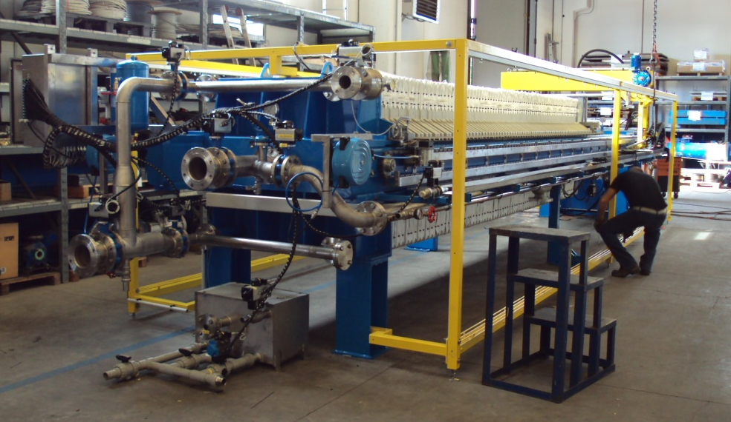
Portfolio
Side bar model (CME TLC)
Type: Side Beam (CME)
Plate transport: One by one (TLC)
Cloths change: You have to remove the plates
Maintenance: More complex than the high beam

Slide 10
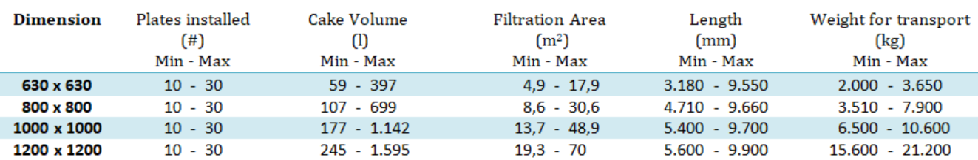
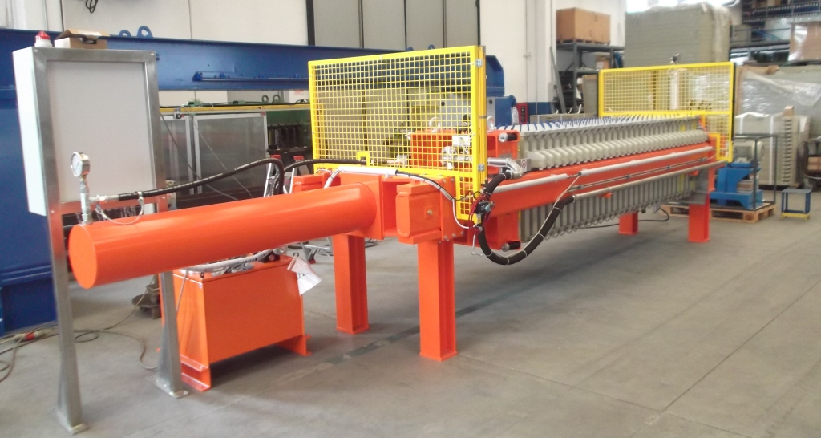
Portfolio
Side bar model (CME IST)
Type: Side Beam (CME)
Plate transport: Simultaneous (IST)
Cloths change: You have to remove the plates
Maintenance: More complex than the high beam

Slide 11
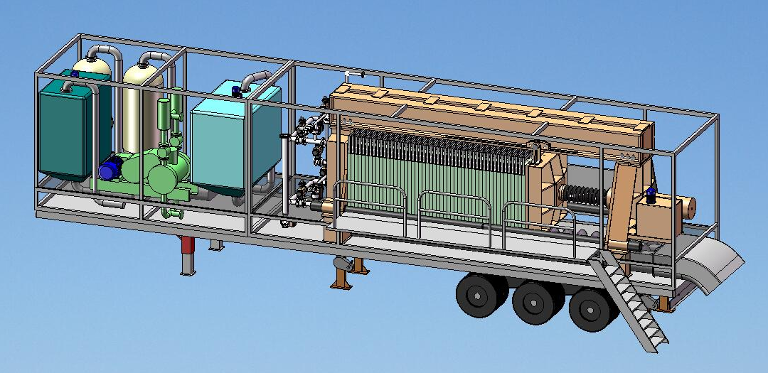
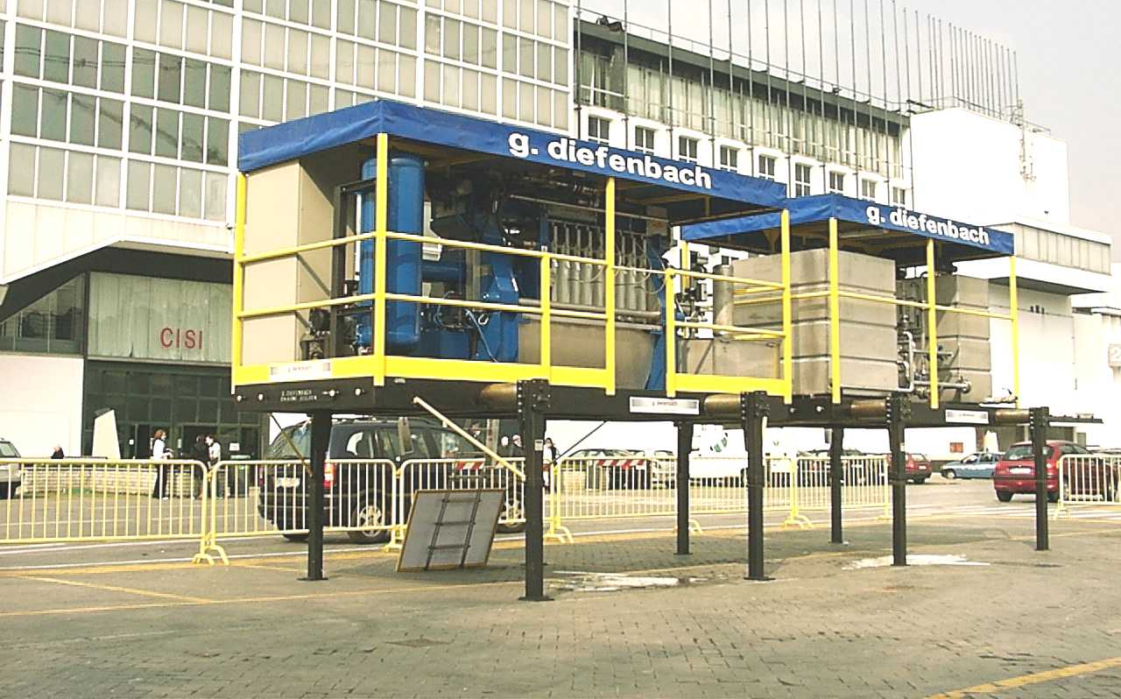
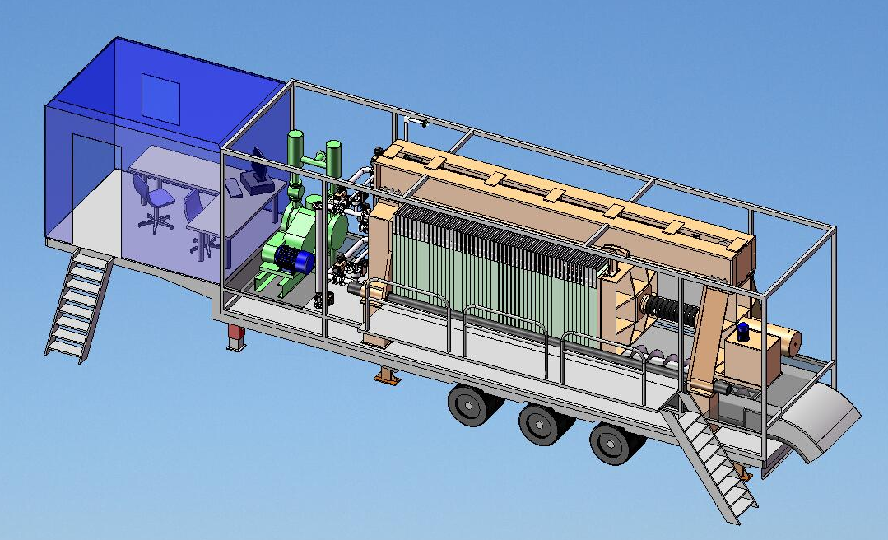
Portfolio
Containerized filters

Slide 12
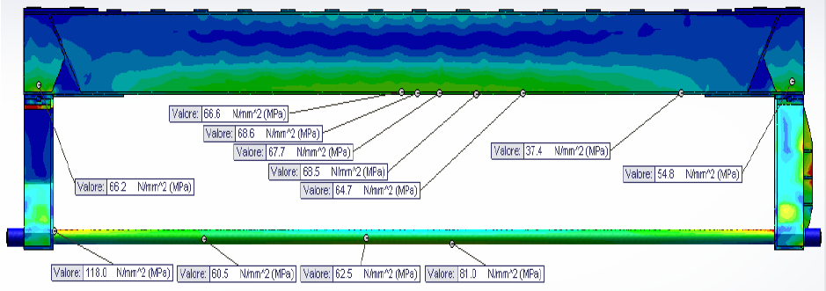
Strength tensile and deflection
The following pictures show the Strength Tensile and Deflection on the superior beams, point by point.
As you can see, the maximum value is no over 11 mm and the maximum Strength is below 69 MPa: very interesting values.
NOTE: every deflection value are checked by formula Diefenbach Company, during its long experience, pick up a lot of solutions and registered a huge quantity of formula date.
The naturally consequence is a little number of Competitors keep up with Diefenbach.

Slide 13
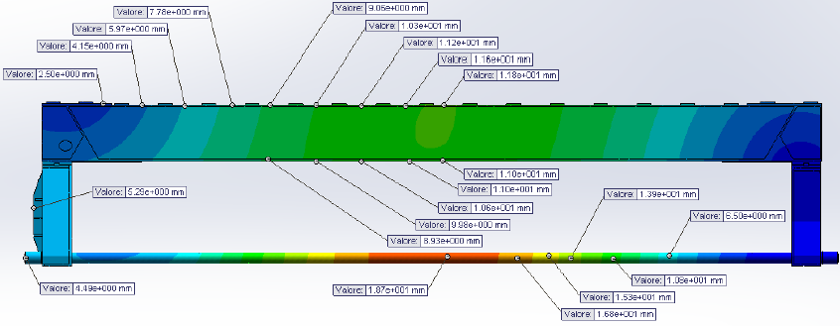
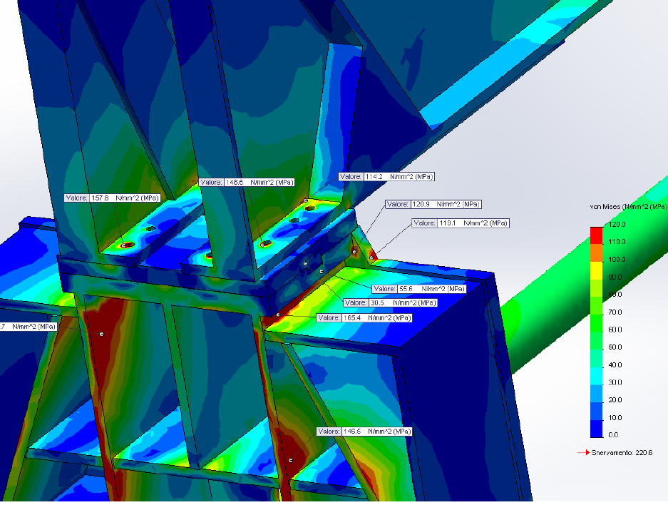
Strength tensile and deflection

Slide 14
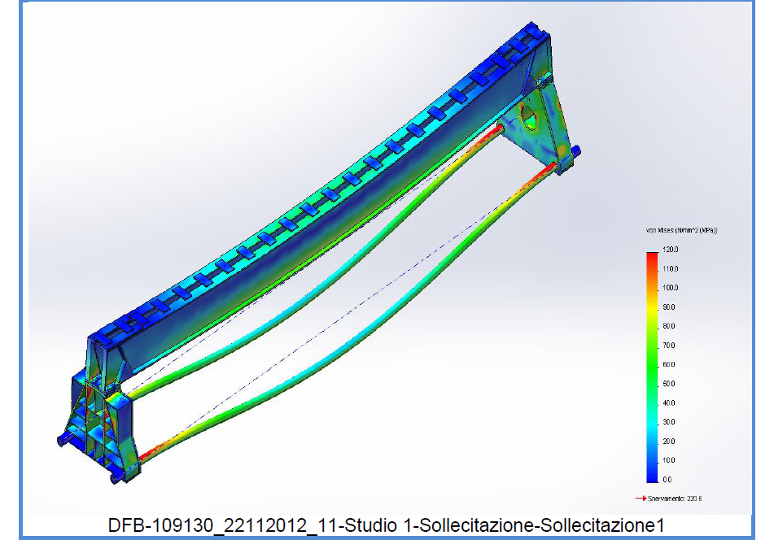
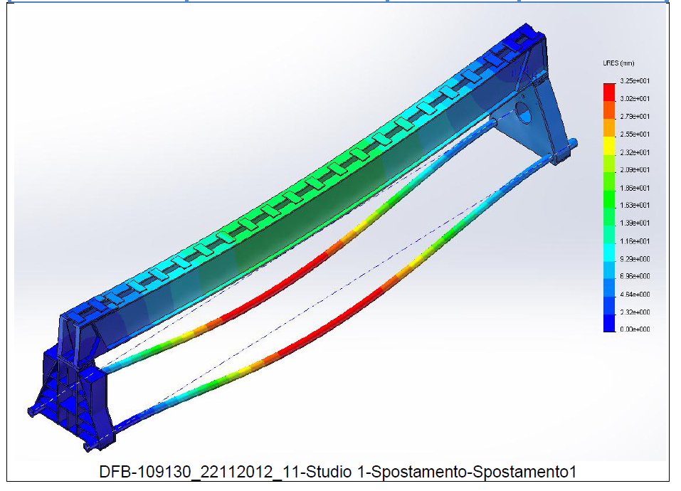
Strength tensile and deflection
SOLICITATIONS
DISPLACEMENT

Slide 15
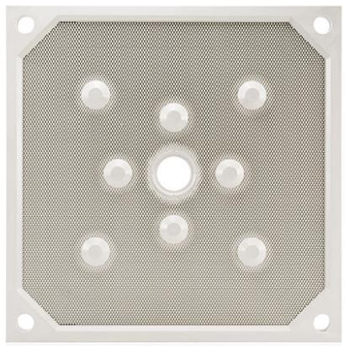
Filter plate
Filter presses can feature recessed or membrane plates;
Plates are squared or rectangular polypropylene (in most of the cases) elements with chambers cut into both sides. Chamber depth can vary;
Membranes can be welded-on or replaceable and come in different materials (according to process);
Purpose of the membranes is to further reduce the moisture content in the cake or just keep the cake firm (avoiding cracks) during the process;
Membranes are inflated with either air or water. For safety reasons, as well as to reduce power consumption, we use water as inflation medium.
Filtrate port
Feeding port

Slide 16
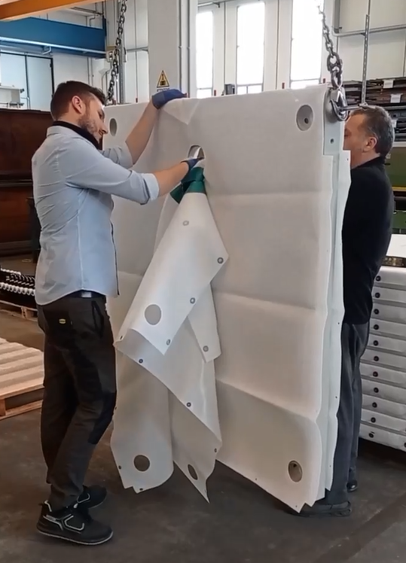
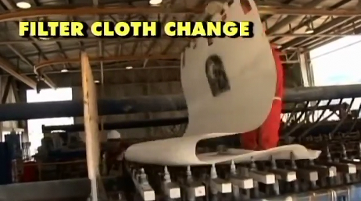
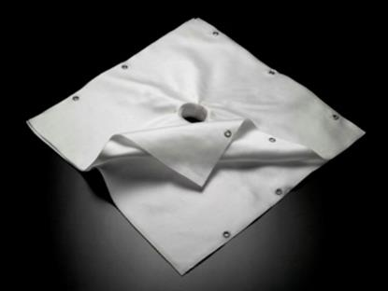
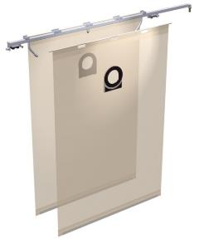
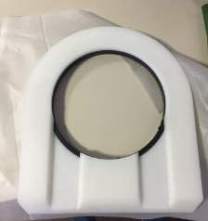
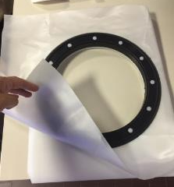
Filter cloth
Barrel neck
Single cloth + feed shoe

Slide 17
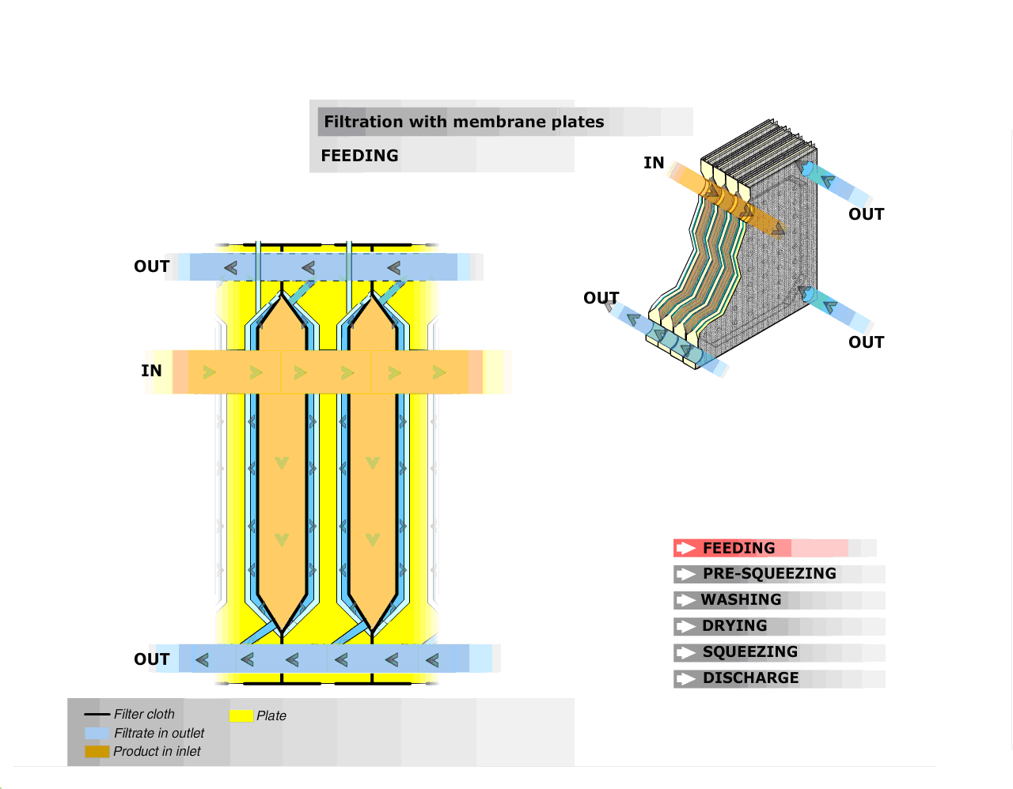
Feeding step
Sludge feeding into the filterpress using a pump.
Once the chambers have been filled with sludge, the pressure of it is increased to the required value: at this point the cloths have trapped the solid phase allowing the free flow of the liquid phase that is directed towards storage tanks through taps placed at side of the plates or, commonly, through outlet flanges located in corner position on the fixed head of the filter.

Slide 18
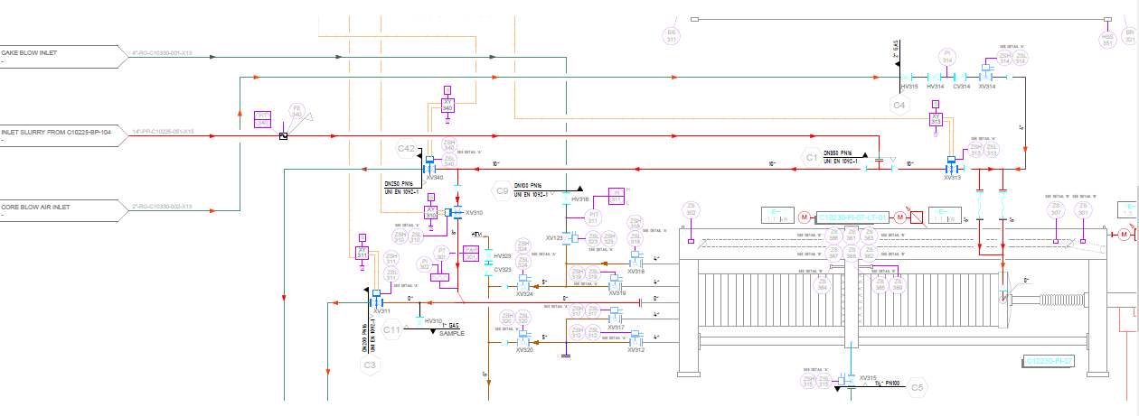
Double end feeding
This feature consists in feeding the filter press from both sides;
The main reason for this is to improve chamber filling and reduce its speed (to be kept below 3 m/s to avoid cloth/plate abrasion);
Concentrates and tailings are easy to filter and usually quite heavy (S.G.). In case of 50 or more plates, there is a risk that not all the chambers get filled. This generates pressure delta, that may eventually break the plates.

Slide 19
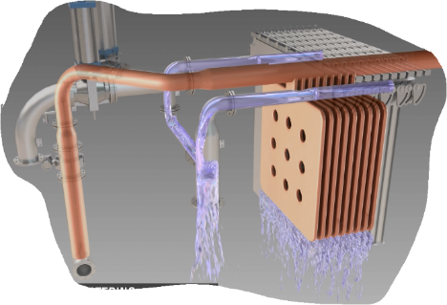
End of filtration
Pressure transducer and time: the end of filtration will be achieved when the pressure reaches the maximum value and the time value pre set in the PLC.
Pressure transducer, filtrate level (in the inspection window or in the lateral launders) and time: the end of filtration will be achieved when the pressure reaches the maximum value and the filtrate is below a set threshold for a time value pre set in the PLC.
Pressure transducer, flow meter and time: the end of filtration will be achieved when the pressure reaches the maximum value, minimum slurry flow (measured by the flow meter) for a time value pre set in the PLC.
Load cells and flow meter (required in case of slurry density variations): in this case the end of filtration is given by the signal sent by the load cells when the weight of the filter is such that the chambers are full and dehydrated. In case the slurry density varies than also a mass flow meter is required. Load cells are installed below the filter press legs. Load cells also ensure that all the cakes are discharged.

Slide 20
Core blow
Core blowing is used to remove unfiltered slurry residues left in the feed channel prior to filter press opening. This prevents final product contamination;
Compressed air is blown from the end plate and pushes unfiltered slurry residues back into the slurry tank.
Slurry back in the tank
Compressed Air
Core

Slide 21
Cake blowing and cake washing
Cake air blowing: air blowing is used to remove residual filtrate in the cake by injecting compressed air from the top corner filtrate ports. The residual filtrate is collected by the bottom filtrate ports and removed;
Cake washing: aimed at removing chemical substances dissolved in the slurry. Specific washing is pumped into the chambers from the bottom filtrate ports. The washing liquor passes through the cakes and flows out of the two top filtrate ports.
Compressed air
Exhausted washing liquor
Residual filtrate
Washing liquor

Slide 22
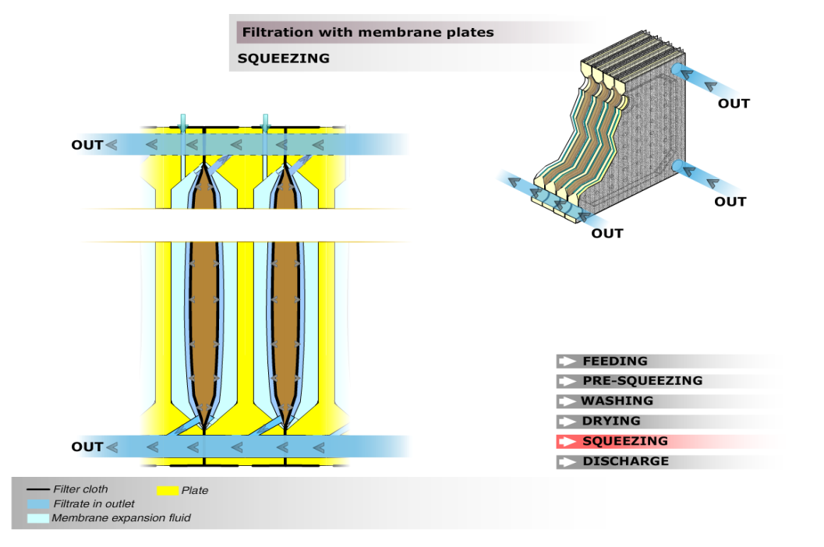
Squeezing
This membrane may be movable (it can be replaced when broken or worn) or integrated (the plate is produced with a propylene membrane already inserted in its body and the membrane can’t be replaced). At the end of the first filtering cycle, the pressure of the sludge is lowered to the environment value: at this point air or water is introduced (better water) in the space between membrane and internal surface of the plate at up to 15 bars pressure. This pressure gives as result by squeezing the cake a further liquid removal from the cake enhancing the performance of the process.

Slide 23
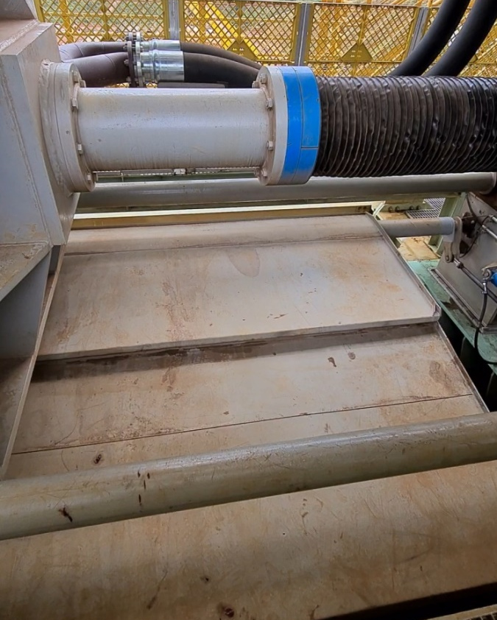
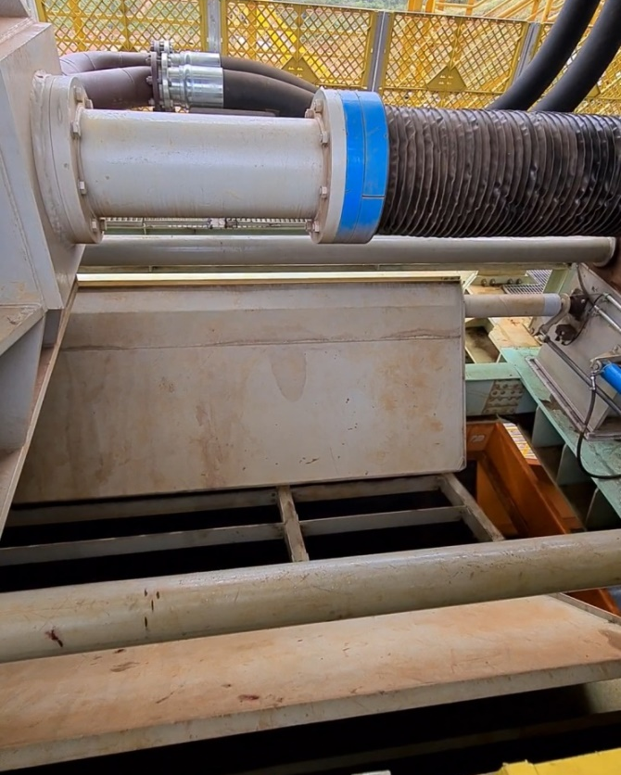
Bomb bay doors (Drip tray)
Bomb bay doors are mounted under the filter plate pack to collect the dripping water during filtration and cloth washing and conduct the water into the filtrate channels;
Bomb doors steel sheets’ material can vary according to process (e.g. carbon steel, AISI 304, polypropylene, etc.);
Bomb bay doors are moved by pneumatic cylinders actuated by a dedicated power pack or connected to the main one (the one moving the piston).

Slide 24
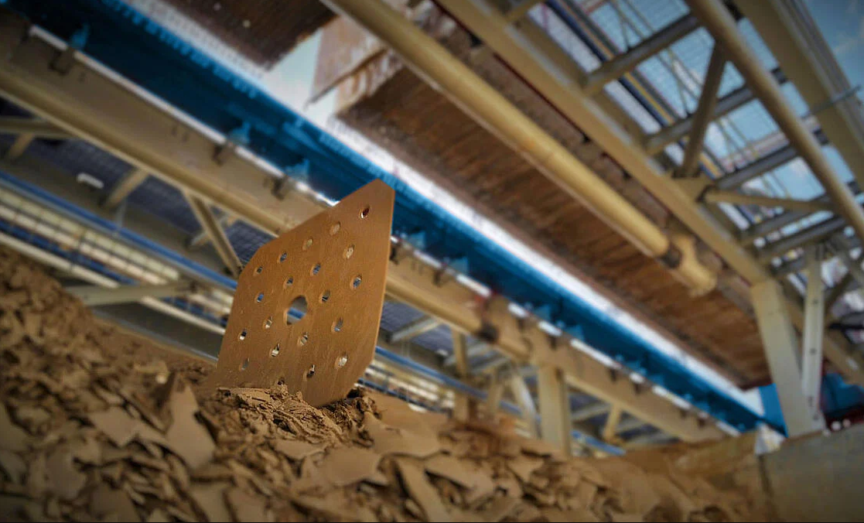
Cake discharge
The following operations are carried out to unload the cake:
Pressure relief from the cylinder
Slight opening of the cylinder to allow dripping
Opening of the bomb bay doors
Complete opening of the cylinder
Plate transport drive

Slide 25
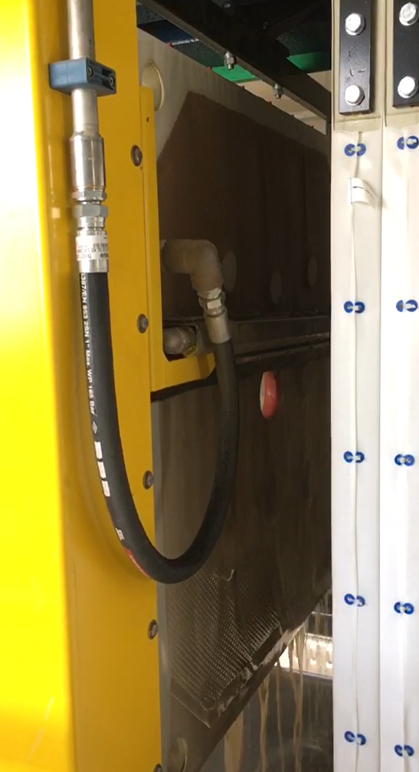
Cloth washing (high pressure)
The washer automatically washes both sides of the plate
Washing is carried out at high pressure (80-100 bar)
Being a wash with such pressures, the cloths are completely regenerated

Slide 26
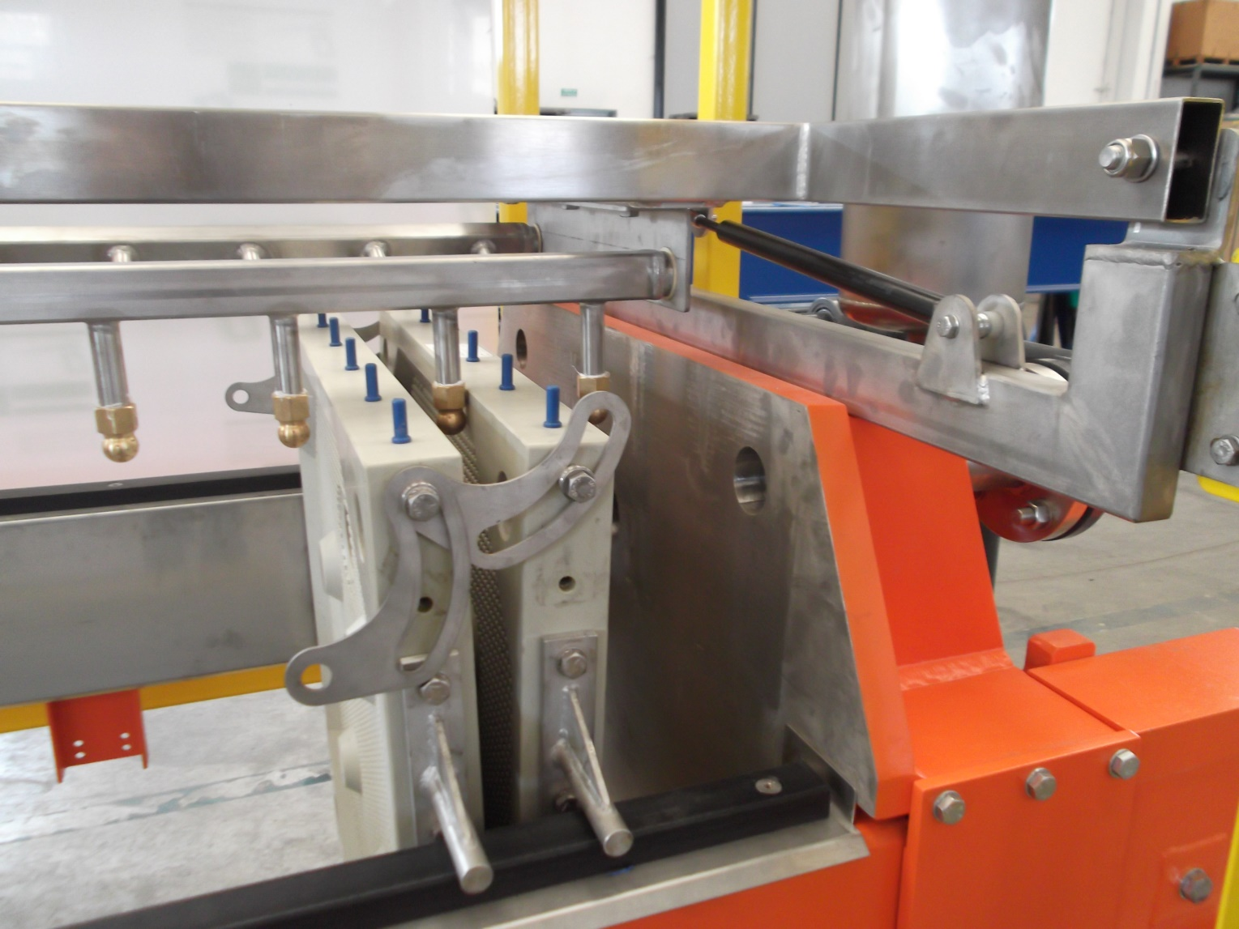
Cloth washing (low pressure)
The purpose of using rain washing is to create a uniform and regular jet of water near the upper part of the plate.
Washing is carried out at low pressure (10 bar)

Slide 27
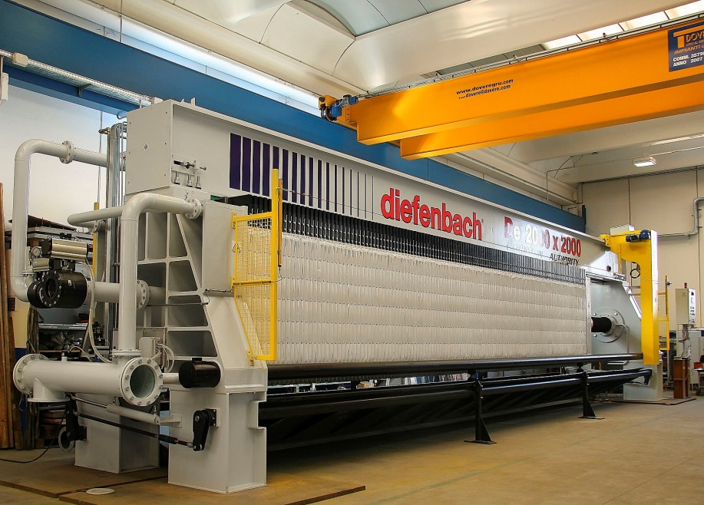
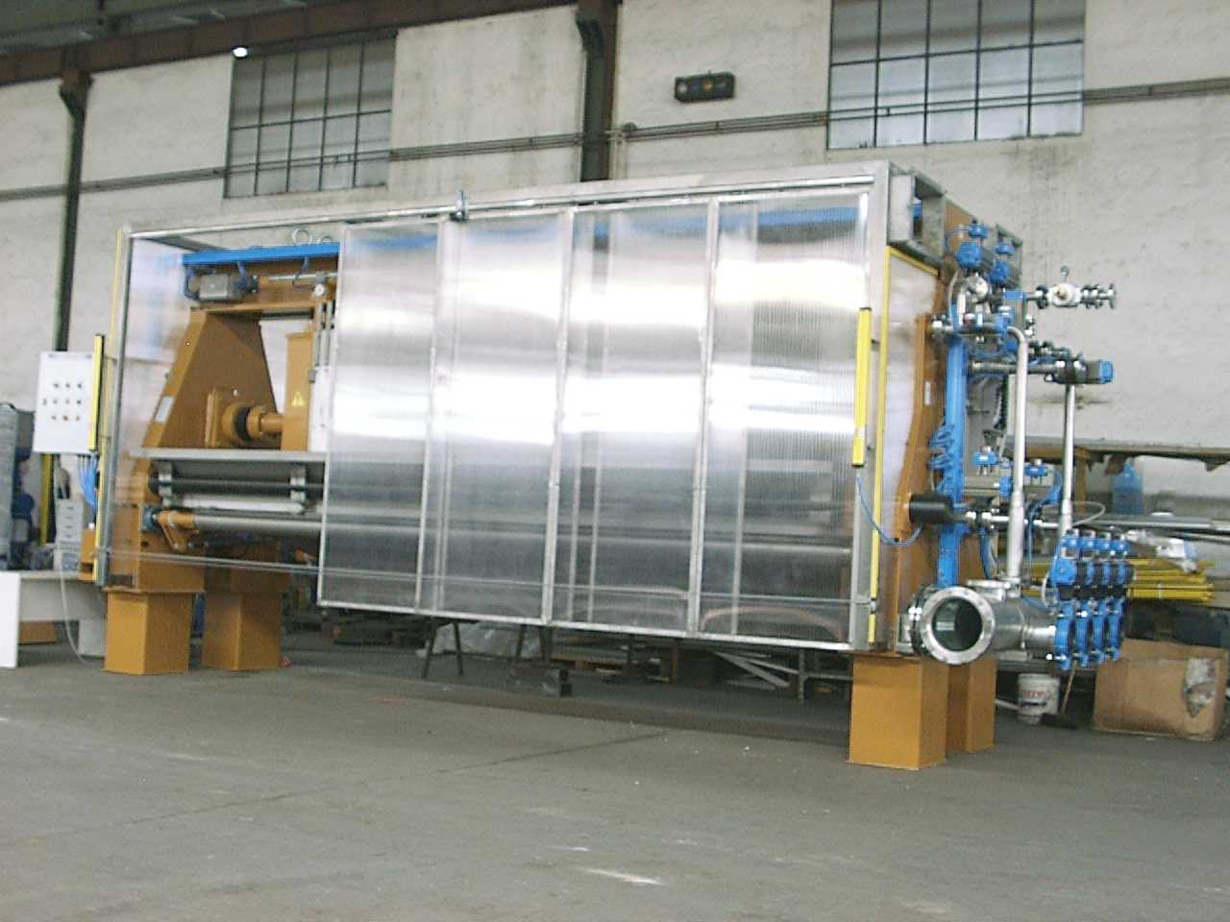
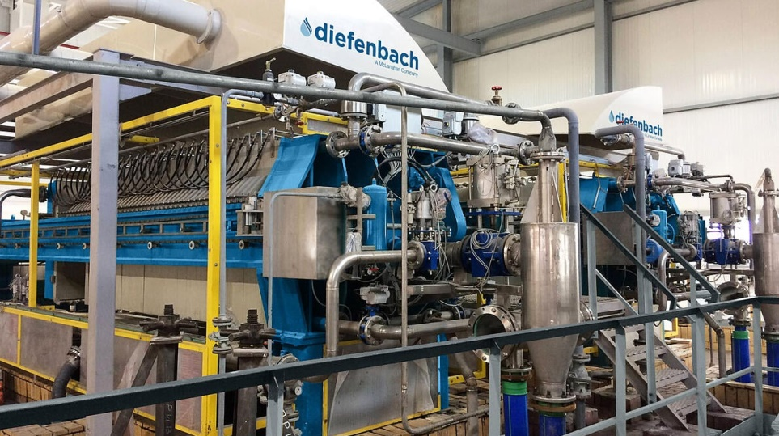
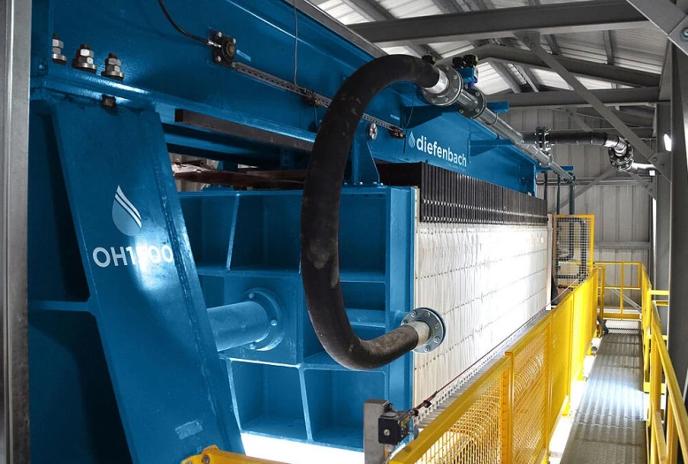
Security features
Consisting of:
Interlocked gates
Polycarbonate Splash Box: sliding panels on the long sides of the
Light barrier against mechanical movements;
Pull-wire switches on the operator sides along the whole length of the filter;
Movable splash curtains to protect against hot, toxic and corrosive slurries.
Extractor hood

Slide 28

Thank you

